Slide 1





Evaluating the Effectiveness of Nature-Based Interventions with Plant-Based Solutions for Wood Preservation( Add your Paper title )
Abstract ID :
Track Title :
TIDAC Research Conference 2025
BRIDGING THE GAP: ENGINEERING, DESIGN & SOCIETY
¹Authors name, Affiliation
²Authors name, Affiliation
³Authors name, Affiliation
Organized by - Faculty of Engineering , NSBM Green University On 13TH November 2025

Slide 2
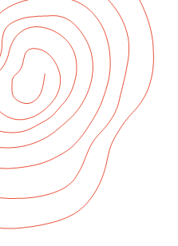




BRIDGING THE GAP: ENGINEERING, DESIGN & SOCIETY
Faculty of Engineering
NSBM Green University
13th November 2024

Slide 3
BRIDGING THE GAP: ENGINEERING, DESIGN & SOCIETY
Faculty of Engineering
NSBM Green University
13th November 2024

Slide 4
BRIDGING THE GAP: ENGINEERING, DESIGN & SOCIETY
Faculty of Engineering
NSBM Green University
13th November 2024

Slide 5
BRIDGING THE GAP: ENGINEERING, DESIGN & SOCIETY
Faculty of Engineering
NSBM Green University
13th November 2024

